Slide 1
Title: Study Habits and Academic Achievement of Medical Students in Egyptian Universities
Course: data exploring and data mining
Dr: Amal Mohamed

Slide 2
Introduction:
Aim: Study habits of medical students
Focus: High achievers By analyzing data from a survey conducted among students, we aim to extract insights into the behaviors associated with success. Academic.
Data: Survey
Importance: Identify effective strategies to enhance academic performance

Slide 3
Materials and Methods:
Data Description: Obtained from the Harvard Dataverse website. It contains 463 observations and includes 46 variables.
Data Mining Methods:
We've combined the variables whose questions assess similar aspects; we end up condensed into 14 variables for ease of discovering and interpretability of data.

Slide 4
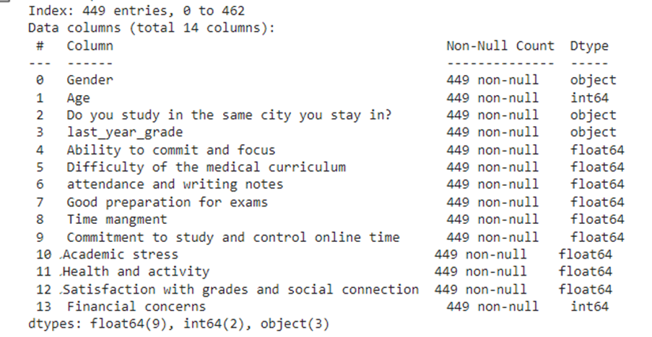
Data Types: Float 9 : This data type is utilized for variables representing questions whose responses are rated on a scale from 1 to 5, 5 indicate stronger agreement
Object 3 Variables: Gender, Grade, Residency

Slide 5
The CRSIP steps:
Business Understanding: Study habits of High achievers
Data Preparation (Preprocess):
Data Cleaning: Unify data format in the last year grade, checked missing values. Outliers were then examined in the 'age. These outliers were corrected using the upper and lower bound method, removing duplicate10 instances.
Data Transformation and Data Discretization: Object variables were converted into dummy variables, and the age variable was normalized. Curse of Dimensionality and Variables Reduction: Through combining similar variables together, by crosstab visualizing.

Slide 6
CRSIP steps:
Business Understanding: Study habits of High achievers
Data Preparation (Preprocess):
Data Cleaning: Unify data format in the last year grade, checked missing values. Outliers were then examined in the 'age. These outliers were corrected using the upper and lower bound method, removing duplicate10 instances.
Data Transformation: Dummy variables, normalization
Variables Reduction: Through combining similar variables together, by crosstab visualizing. Data Cleaning: Unifying formats, checking missing values

Slide 7
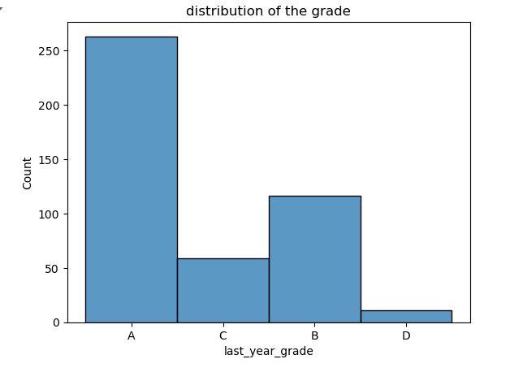
CRSIP steps: data understanding
Graphical Examination: Grade distribution

Slide 8
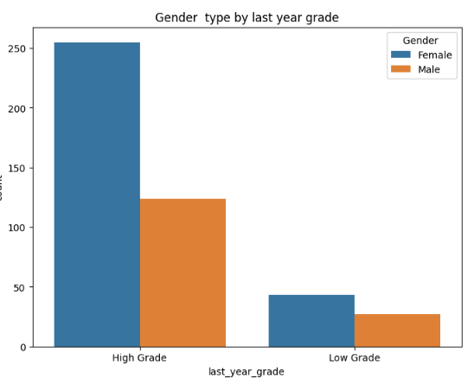
CRSIP steps: data understanding
Influential Factors: Gender

Slide 9
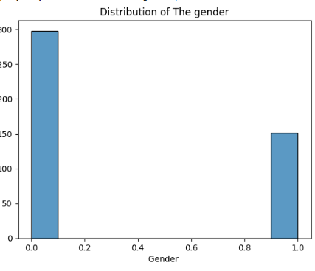
CRSIP steps: Data Understanding The same case as universities then deleted

Slide 10
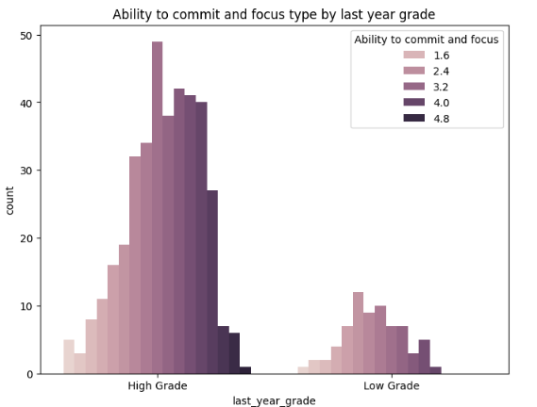
CRSIP steps: data understanding
Patterns in study habits: lecture commitment, focus

Slide 11
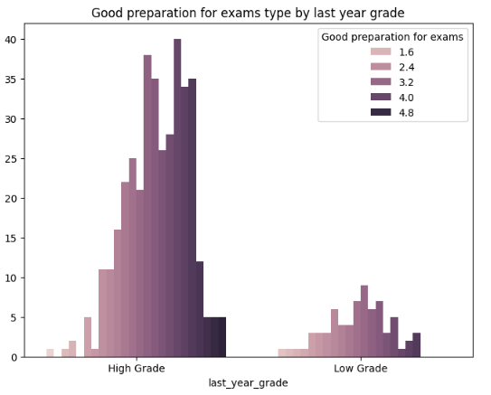
CRSIP steps: data understanding
Patterns in study habits: Exam preparation

Slide 12
CRSIP steps: data understanding
Patterns in study habits: Exam preparation

Slide 13
Our findings suggest a positive correlation between specific study habits,: such as exam preparation, commitment to lectures, focused learning. Factors like effective time management, physical activity, sleep prioritization, access to educational resources
contribute to academic success.
.

